Slide 1

#LifeKoKaroLift
Data Science Certification Program

Slide 2


Course : Data Science
Lecture On : Pandas
Instructor : Shivani Kapania

Slide 3
In Last Class, we covered….
Pandas basics
Creating Series and DataFrame objects
Indexing and selecting rows and columns

Slide 4
Today’s Agenda
Position based and label based indexing
Concatenating dataframes

Slide 5
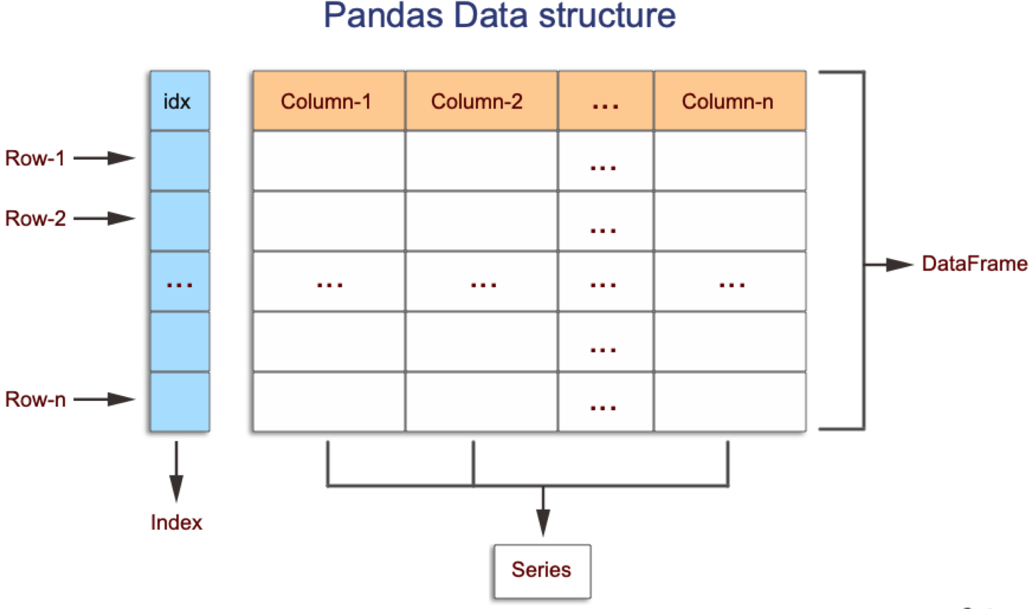
Pandas Dataframe

Slide 6
Position based indexing: iloc
Purely integer-location based indexing for selection by position.
.iloc[] is primarily integer position based (from 0 to length-1 of the axis), but may also be used with a boolean array.
When slicing, the start bounds is included, while the upper bound is excluded.
Allowed inputs are:
An integer, e.g. 5.
A list or array of integers, e.g. [4, 3, 0].
A slice object with ints, e.g. 1:7.
A boolean array.

Slide 7
Label based indexing: loc
Access a group of rows and columns by label(s) or a boolean array.
When slicing, both the start bound AND the stop bound are included, if present in the index. Integers are valid labels, but they refer to the label and not the position.
Valid inputs:
A single label, e.g. 5 or 'a' (Note that 5 is interpreted as a label of the index. This use is not an integer position along the index.).
A list or array of labels ['a', 'b', 'c'].
A slice object with labels 'a':'f'
A boolean array.

Slide 8
pd.concat(objs, axis=0, join='outer' ..)
Concatenate pandas objects along a particular axis with optional set logic along the other axes.
Can also add a layer of hierarchical indexing on the concatenation axis, which may be useful if the labels are the same (or overlapping) on the passed axis number.

Slide 9
#LifeKoKaroLift
Thank You!

